Slide 1
Evaluating Generative Agent Simulation Performance

Slide 2
Goal: Increase sales with young consumers
Approach: Run human simulations to gain insights into consumer behaviour
Problem: How can we evaluate the quality of the human simulations?
→ We want to ensure decisions are based on accurate and reliable data

Slide 3
Existing Evaluation Approaches
Our evaluation approach must examine how human simulations behave—and why—in comparison to real humans
N-gram Overlap
(e.g., ROUGE, BLEU)
Embedding-based
(e.g., BERTScore)
Generic LLM-as-a-Judge
(e.g., G-Eval, RAGAs, FActScore)
- Ignores semantics
- No nuanced evaluation
- No correlation with humans
- Many stylistic evaluations
- Too generic

Slide 4
Proposed Evaluation Approach
1
Extract reasoning arguments (why) & conclusions (how) from answers
Question: Where do you typically purchase your personal care products and why?
Answer: To be efficient and for convenience, I buy my personal care products at my nearest supermarket.
2
Compare reasoning arguments & conclusions of simulated and human answers
Reasoning Arguments
- efficiency
- convenience
- …
Reasoning Arguments
- discounts
- convenience
- …
Conclusions
- online
- physical store
- …
Conclusions
- online
- supermarket
- …
👤
🤖
…
👤
🤖
…
3
Compute Evaluation Scores
Average Argument Recall (0-1)
→ How many of the human arguments are included in the simulated arguments?
Average Conclusion Alignment (0-1)
→ Do simulated and human answers reach the same conclusion?

Slide 5
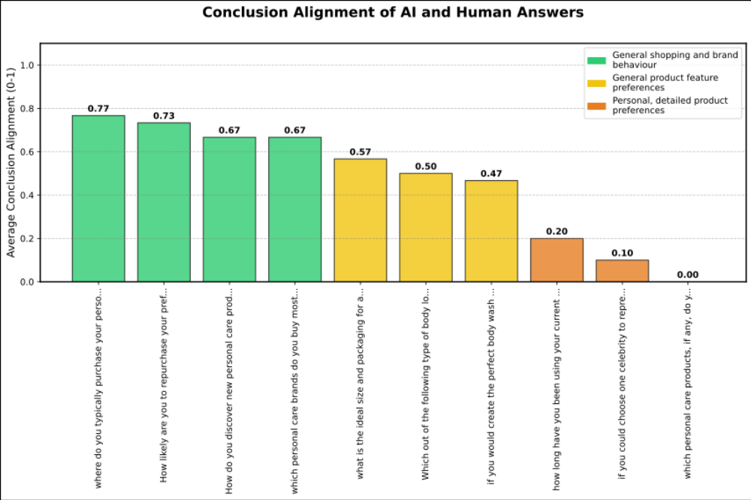
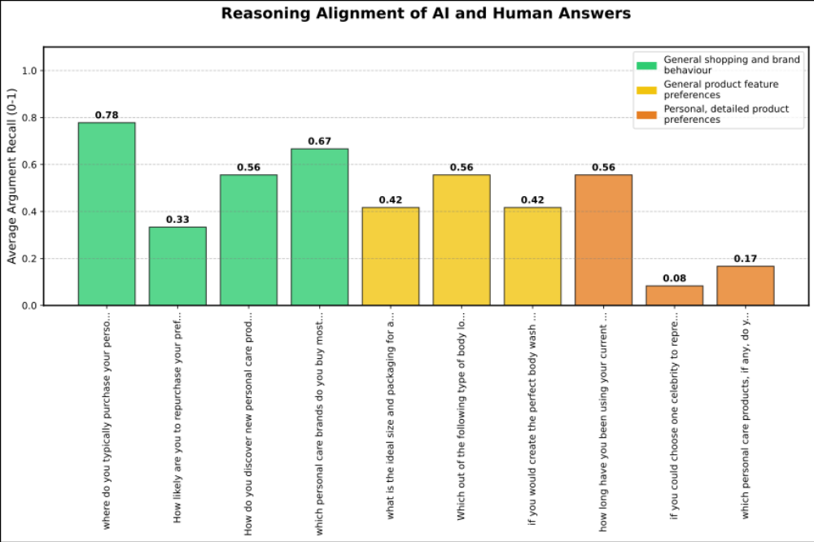
Results
Similar behaviors are observed for general shopping and brand preferences
Simulations are not well-suited to replicate the personal and detailed product preferences of real people
Humans and simulations might give the same answer conclusion for different reasons, meaning their thinking isn’t always aligned.

Slide 6
Conclusion
We must evaluate how human simulations behave—and why—in comparison to real humans
Existing evaluation approaches are unsuitable
We evaluate answer conclusions (how) and reasoning arguments (why)
Investigating both provides evidence of how accurately simulations can mimic real human answers

Slide 7
Supplemental
Participant | Average Conclusion Alignment | Average Argument Recall
c_human | 0.53 | 0.56
g_human | 0.46 | 0.40
s_human | 0.41 | 0.40
Question Category | Average Conclusion Alignment | Average Argument Recall
Brand Loyalty | 0.73 | 0.33
Product Preferences | 0.48 | 0.52
Shopping Behaviour | 0.48 | 0.50
Influences | 0.10 | 0.08

